Slide 1
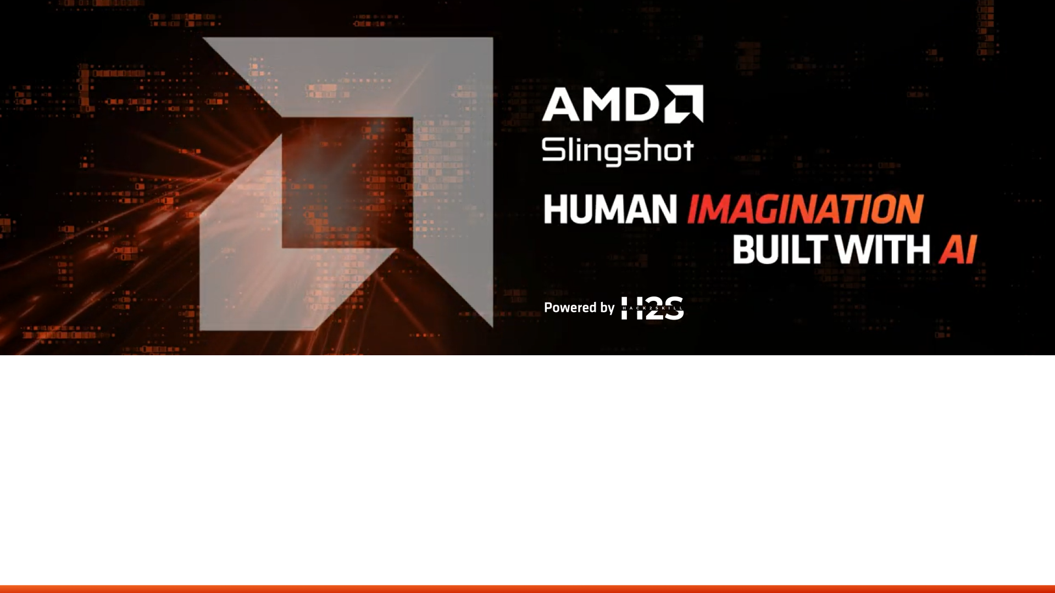
Team Details
Team name -
Team leader name -
Problem Statement -

Slide 2

Brief about the idea
Develop a real-time AI system that detects whether a video, image, or live webcam feed is real or deepfake using deep learning models accelerated by AMD hardware.
How it Works:
Captures input from webcam or video
Extracts frames and analyzes facial features using CNN models
Runs inference using AMD GPU acceleration with ROCm
Displays REAL / FAKE result with confidence score instantly
Innovation:
Real-time detection with low latency
Optimized using AMD GPUs
Demonstrates faster performance compared to CPU systems
Impact:
Helps prevent misinformation, fake media spread, and digital fraud in social media, news, and cybersecurity.
Outcome:
A fast, accurate, and scalable deepfake detection system powered by AMD AI ecosystem.

Slide 3
Opportunities
How different is it from any of the other existing ideas?
Optimized for AMD GPUs using ROCm instead of NVIDIA-dependent solutions
Performs real-time detection on live webcam and edge devices, not just offline analysis
Includes performance benchmarking showing faster inference on AMD hardware
Lightweight and deployable on consumer AMD systems
How will it be able to solve the problem?
Instantly analyzes video frames and detects manipulated content
Alerts users with REAL / FAKE result and confidence score before sharing
Helps prevent misinformation, identity fraud, and fake media spread
Can integrate with social media, video calls, and verification platforms
USP of the proposed solution
Real-time, AMD-accelerated deepfake detection with low latency
Edge-ready solution that works without cloud dependency
Faster and more cost-efficient than CPU-based systems
Practical deployment with dashboard and live monitoring

Slide 4
List of features offered by the solution
Real-Time Detection: Identifies deepfakes instantly from webcam, video, or image input
AMD GPU Acceleration: Uses ROCm on AMD GPUs for fast inference
High Accuracy AI Model: Deep learning model trained to detect facial manipulation artifacts
Confidence Score Output: Displays REAL / FAKE result with probability percentage
Live Monitoring Dashboard: User-friendly interface with real-time results and alerts
Fake Region Highlighting: Visual heatmap showing manipulated areas of the face
Edge Deployment Support: Runs locally on AMD Ryzen AI devices without cloud dependency
Performance Benchmarking: Shows speed comparison between CPU and AMD GPU
Multi-Format Support: Works with live video, recorded video, and images
Scalable Integration: Can be integrated into social media, video conferencing, and security systems

Slide 5
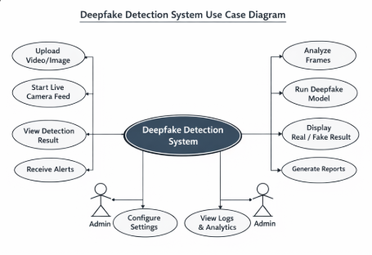

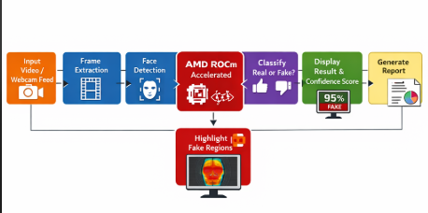
Process flow diagram or Use-case diagram

Slide 6
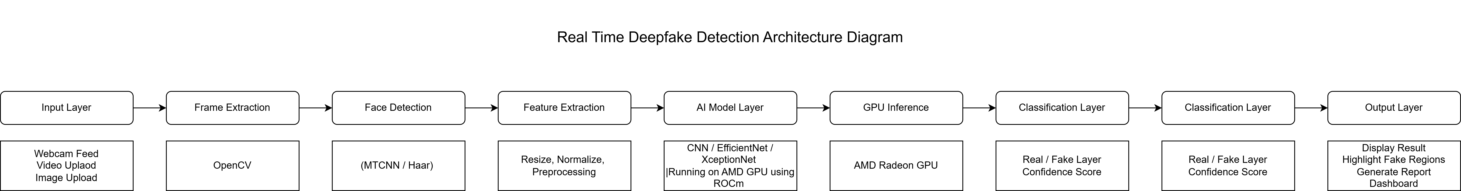
Architecture diagram of the proposed solution

Slide 7
Technologies to be used in the solution
Hardware:
AMD Radeon / AMD Instinct GPU – AI acceleration
AMD Ryzen Processor – Edge and system processing
AMD AI Stack:
ROCm – GPU acceleration for training and inference
ONNX Runtime – Optimized model execution on AMD hardware
AI / ML Development:
Python – Core programming language
PyTorch (ROCm) – Deepfake detection model
OpenCV – Video and frame processing
Frontend / Interface:
Streamlit / Flask – Real-time detection dashboard
HTML, CSS, JavaScript – User interface
Tools & Deployment
GitHub – Version control
Docker – Deployment and portability
Deepfake Dataset (FaceForensics++) – Model training

Slide 8
Usage of AMD Products/Solutions
AMD GPU Acceleration:
AMD Radeon / AMD Instinct GPUs used to run deep learning models for fast deepfake detection
Provides high-performance parallel processing for real-time inference
AMD ROCm Platform
ROCm used to train and deploy PyTorch deep learning models
Enables GPU acceleration, reducing detection time and improving efficiency
AMD Ryzen Processor (Edge Deployment)
AMD Ryzen CPU used for system control, preprocessing, and running edge AI locally
Supports real-time detection without cloud dependency
Performance Optimization
Demonstrates faster processing compared to CPU-only systems
Shows efficient utilization of AMD hardware for AI workloads
Scalable AMD AI Ecosystem
Solution can scale from Ryzen AI edge devices to AMD Instinct data center GPUs
Showcases AMD end-to-end AI capability from edge to server

Slide 9
